Slide 1
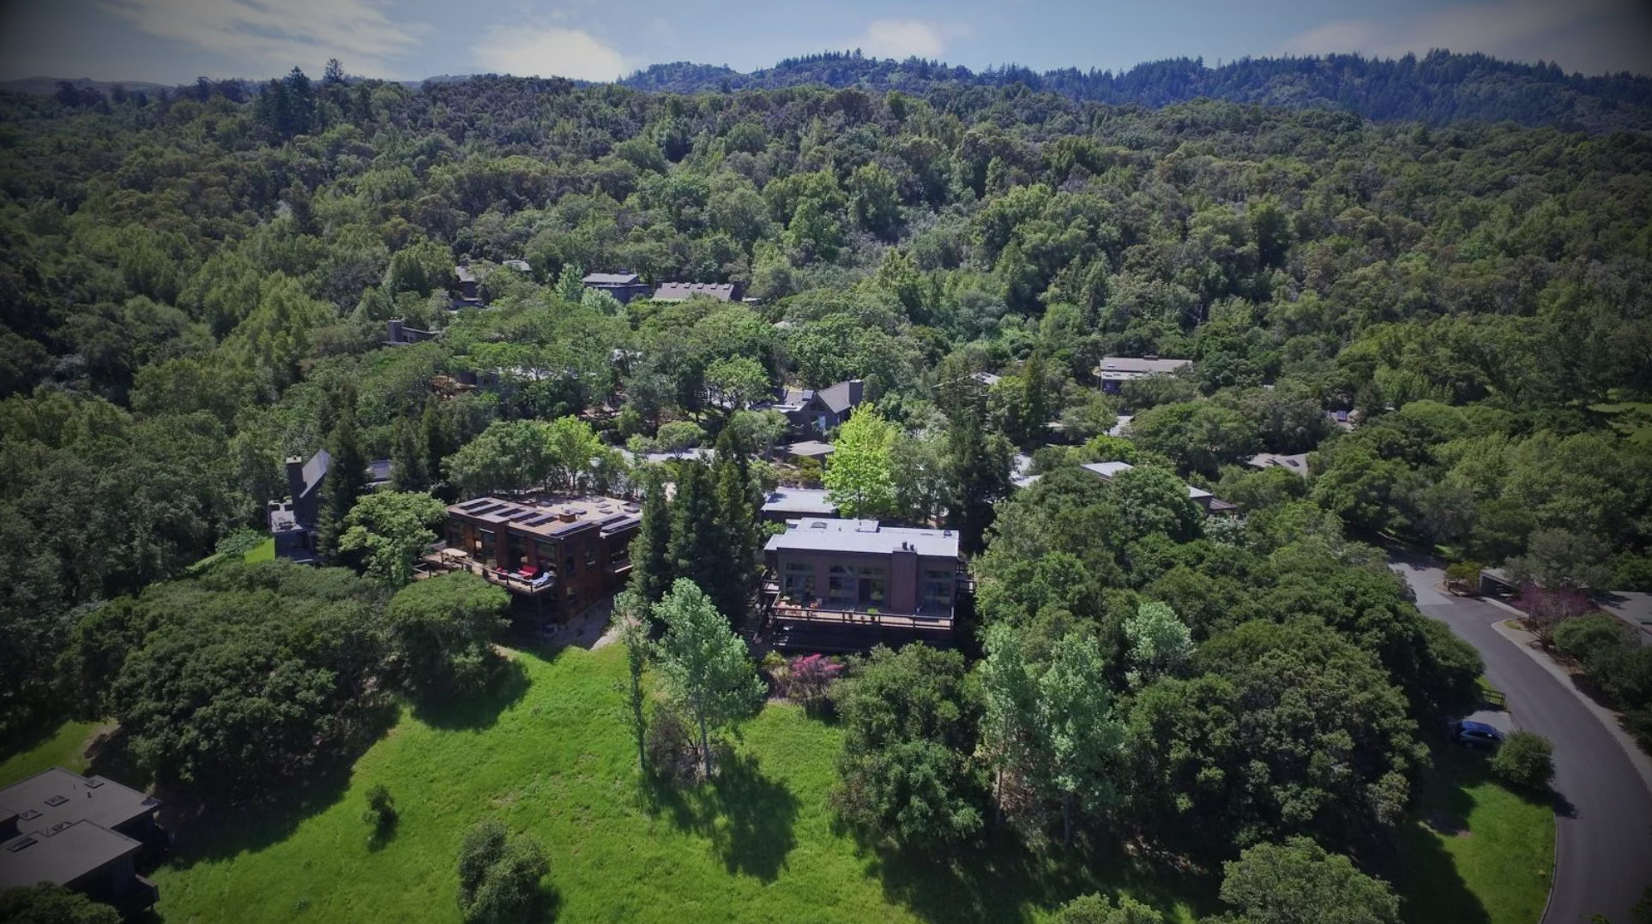
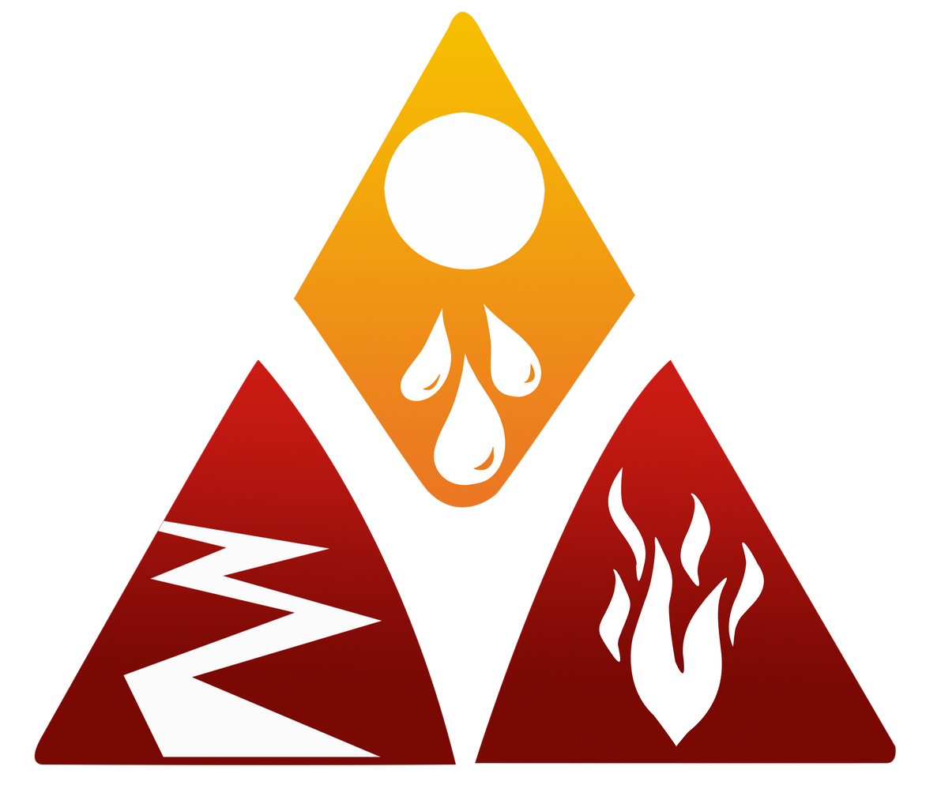
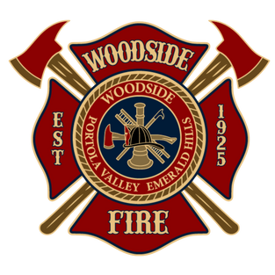
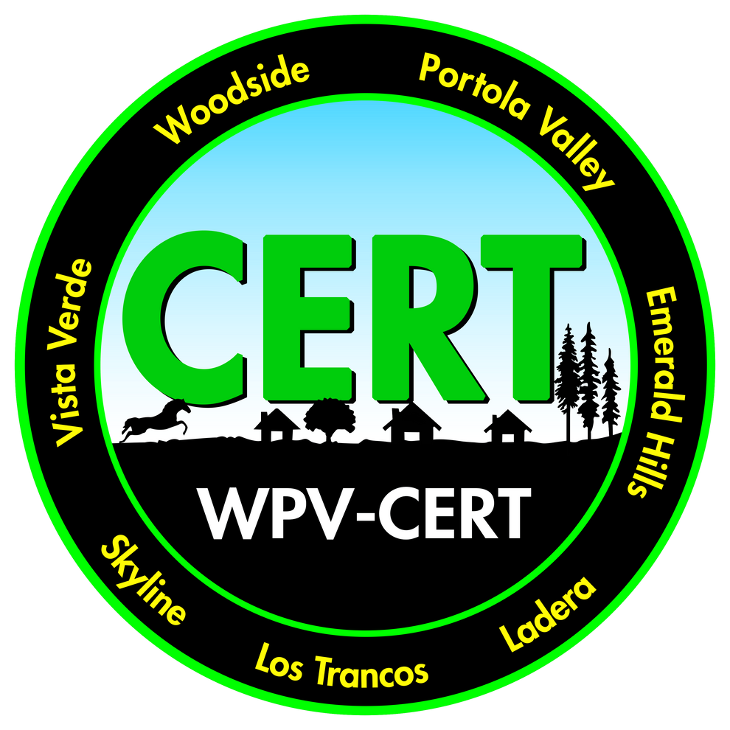
WPV-READY NODES
Connecting Neighbors - Strengthening Resilience
Notes:
Welcome, everyone! I’m excited to introduce you to the WPV Ready Node concept — a neighborhood-based system that helps our communities stay connected and resilient during disasters.
This effort is part of WPV-Ready, in partnership with Woodside Fire and our WPV-CERT program.

Slide 2
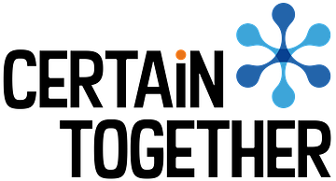
Acknowledgements
Village Hub Model
The WPV-Ready Node program is an adaptation of the Village Hub model developed by David Smathers Moore of Certain Together (certaintogether.org). WFPD thanks David Smathers Moore and Certain Together for the generous open licensing of their materials.
Seattle Emergency Communications Hubs
The original Seattle Emergency Communication Hubs program is acknowledged for inspiring the Village Hub framework and, in turn, the WPV-Ready Node program.
WPV-Ready Node Program
Developed by the Woodside Fire Protection District. WPV-Ready is a program under EPiC, Inc., in partnership with WFPD.
Notes:
Before we get started, I want to give credit where it's due.
The Node program is adapted from the Village Hub model created by David Smathers Moore of Certain Together. He built on the original Seattle Emergency Communication Hubs — a grassroots neighbor-helping-neighbor system that grew out of a major windstorm in 2006. David took that concept and developed it into a framework others could use.
We're grateful he made those materials available. We've tailored the model for Woodside and Portola Valley, but it stands on the shoulders of their work.
You can learn more about Certain Together at certaintogether.org.

Slide 3
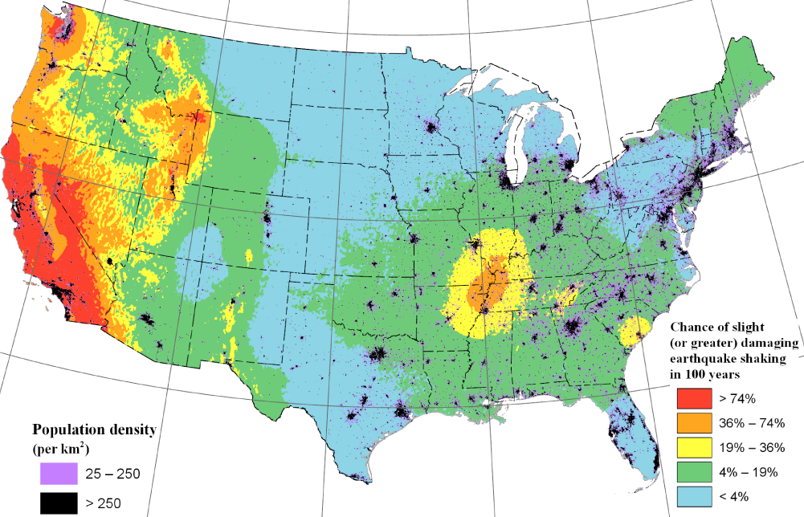
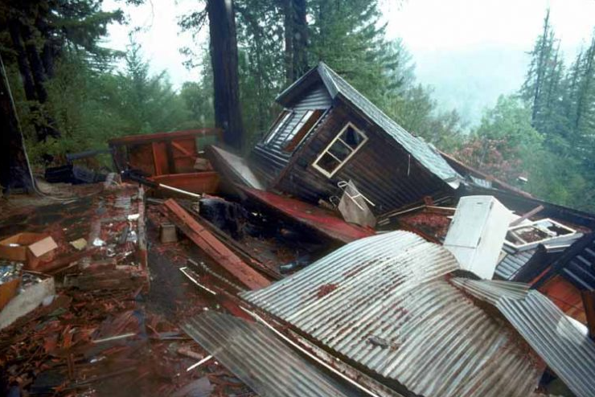
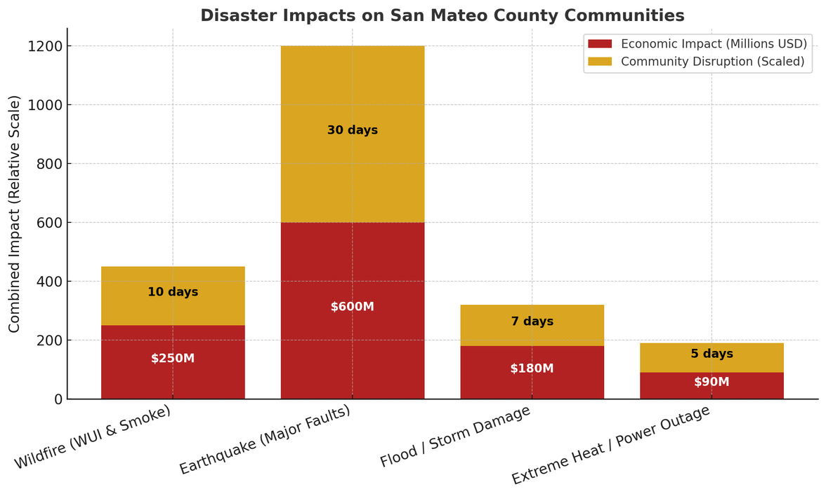
Loma Prieta, 1989
THE RISK IS REAL.
Notes:
Let’s start with some perspective — there’s a 72% chance of a magnitude 6.7 or greater earthquake hitting the Bay Area within the next 30 years. And if we look at the larger picture, the diagram shows that California faces the highest likelihood of a damaging earthquake within the next 100 years — more than any other state.
We live in earthquake country. It’s not a question of if, but when.
When it happens, our ability to recover will depend on how well we’ve prepared — not just individually, but as neighborhoods and as a community.
The chart below expands that perspective, showing the broader range of disasters that can affect us here in San Mateo County. The red bars show the economic cost of each event, while the gold sections represent how long daily life is disrupted — things like power outages, smoke days, flooding, or road closures.
While earthquakes carry the greatest overall impact, wildfires and severe storms are the events we’re most likely to face year after year. And as our climate shifts, extreme heat and power shutoffs are becoming increasingly common concerns.
Together, these risks remind us that preparedness isn’t about fear — it’s about resilience. The more we plan, the faster we recover, and the stronger our community becomes.

Slide 4
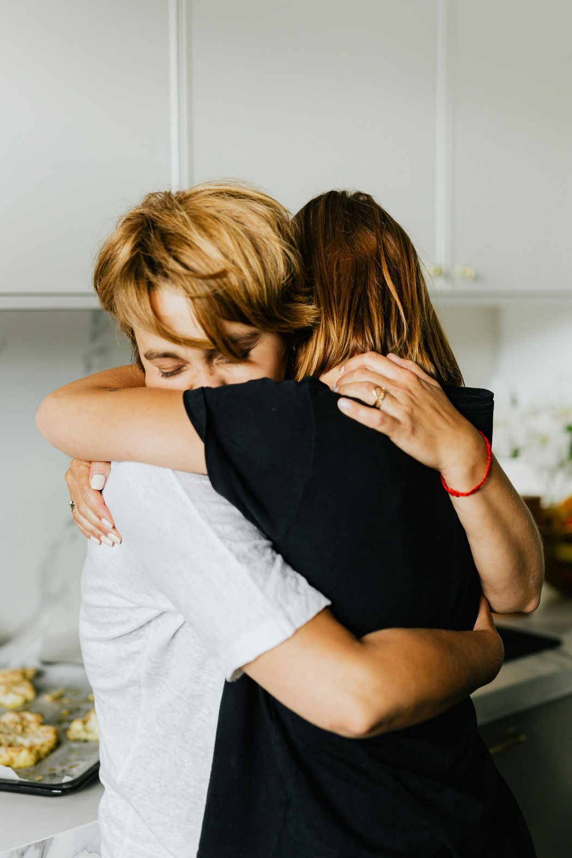
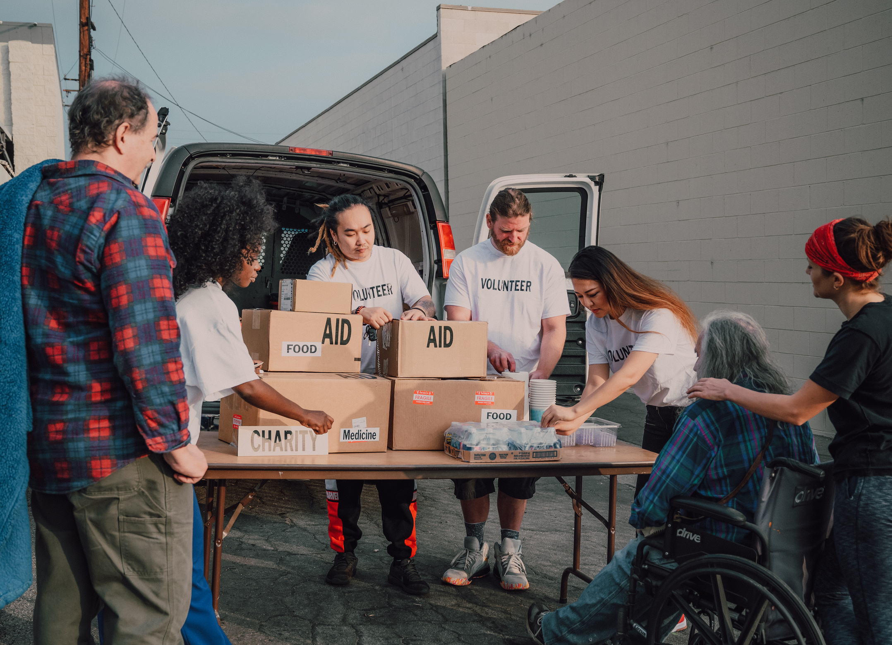
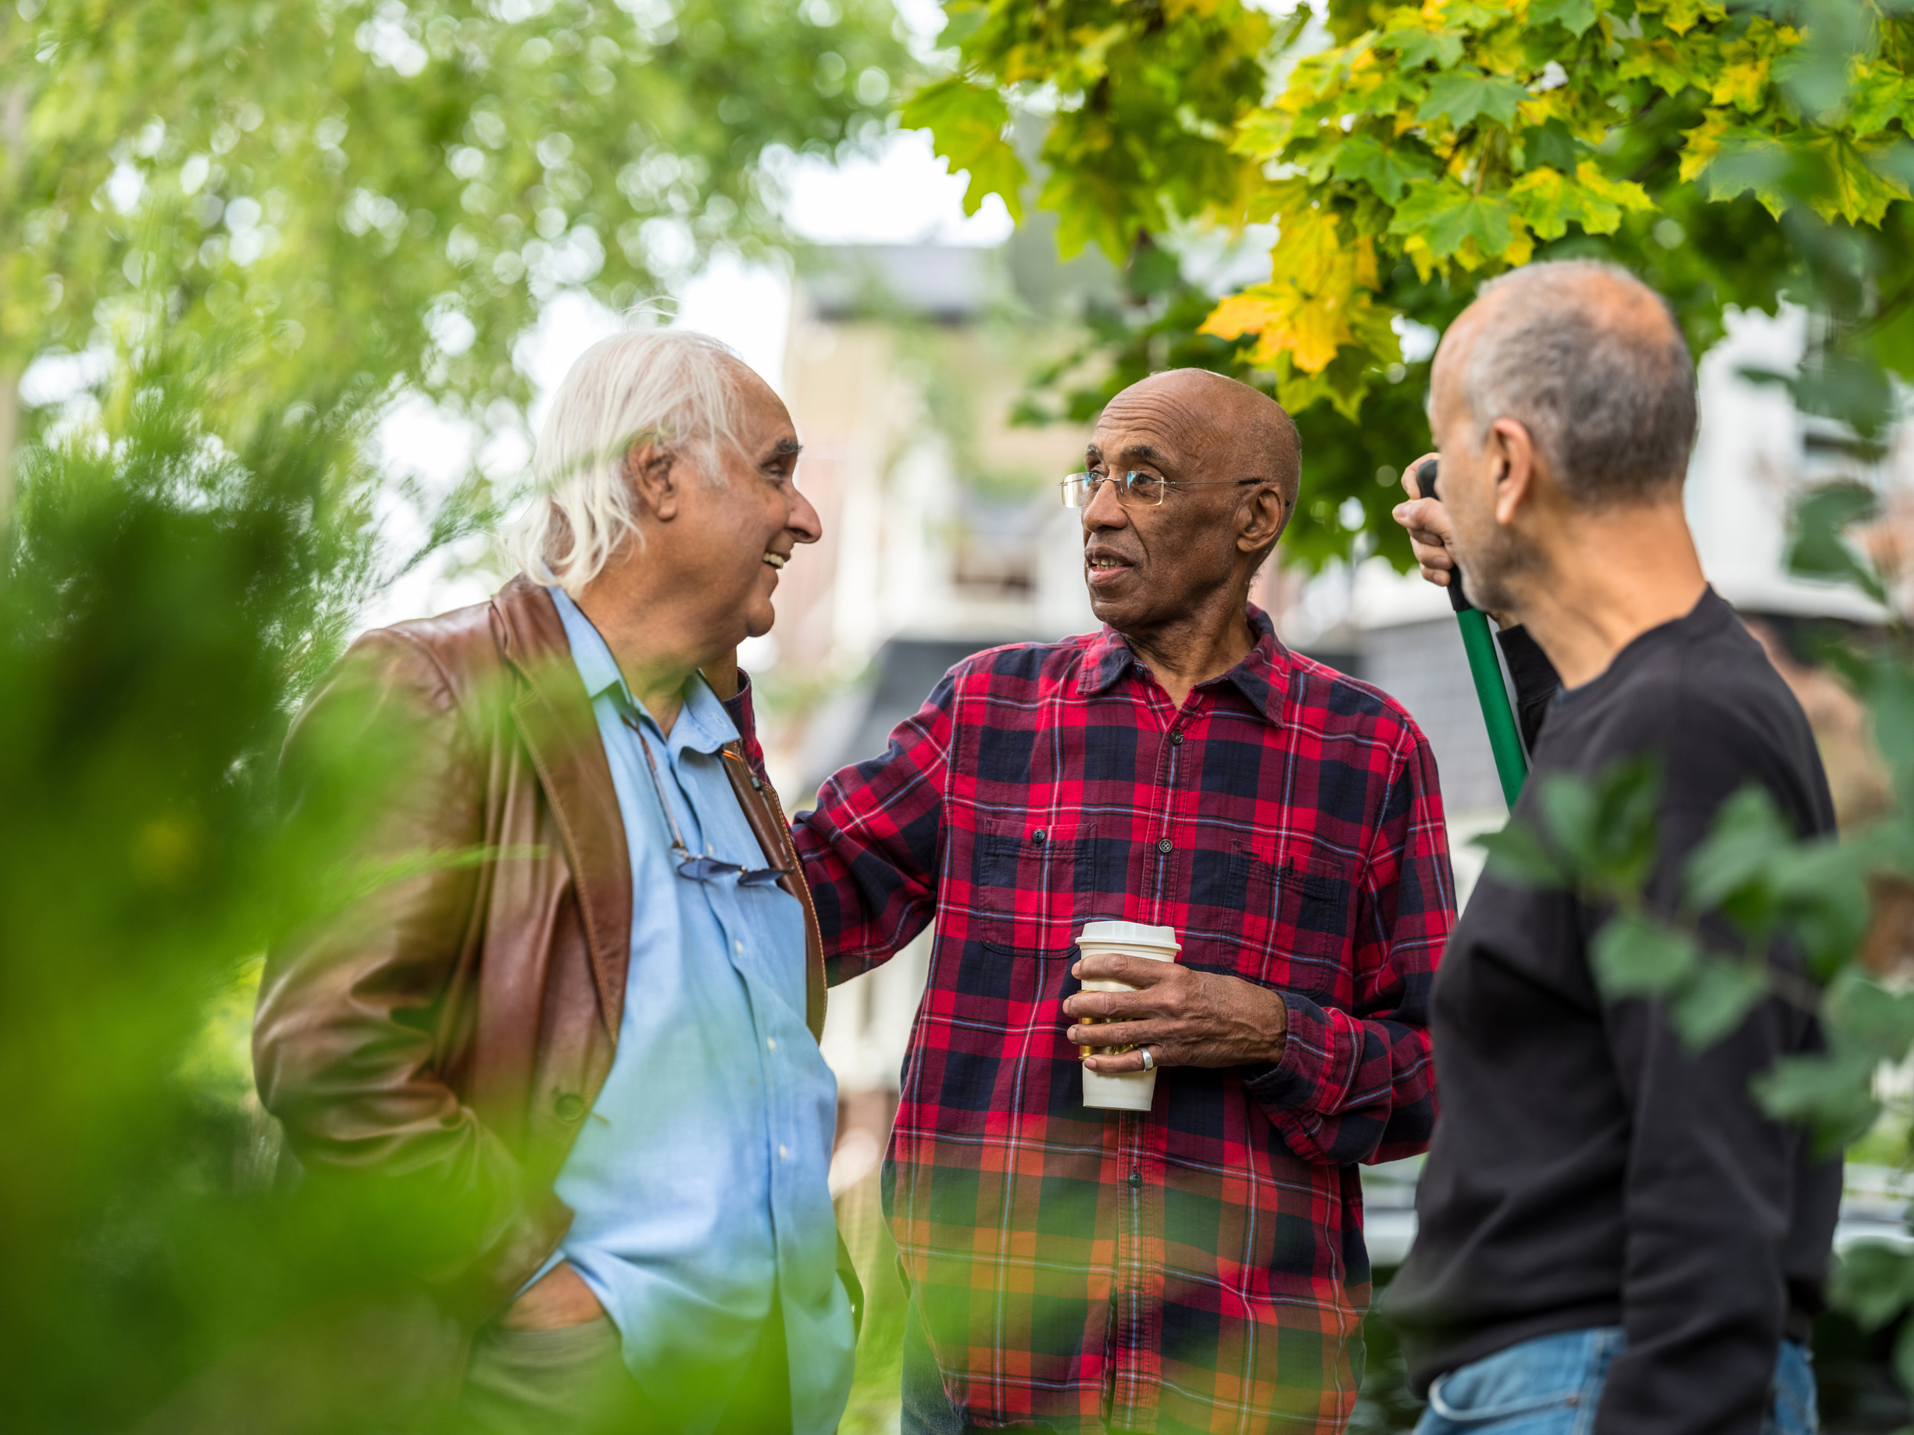
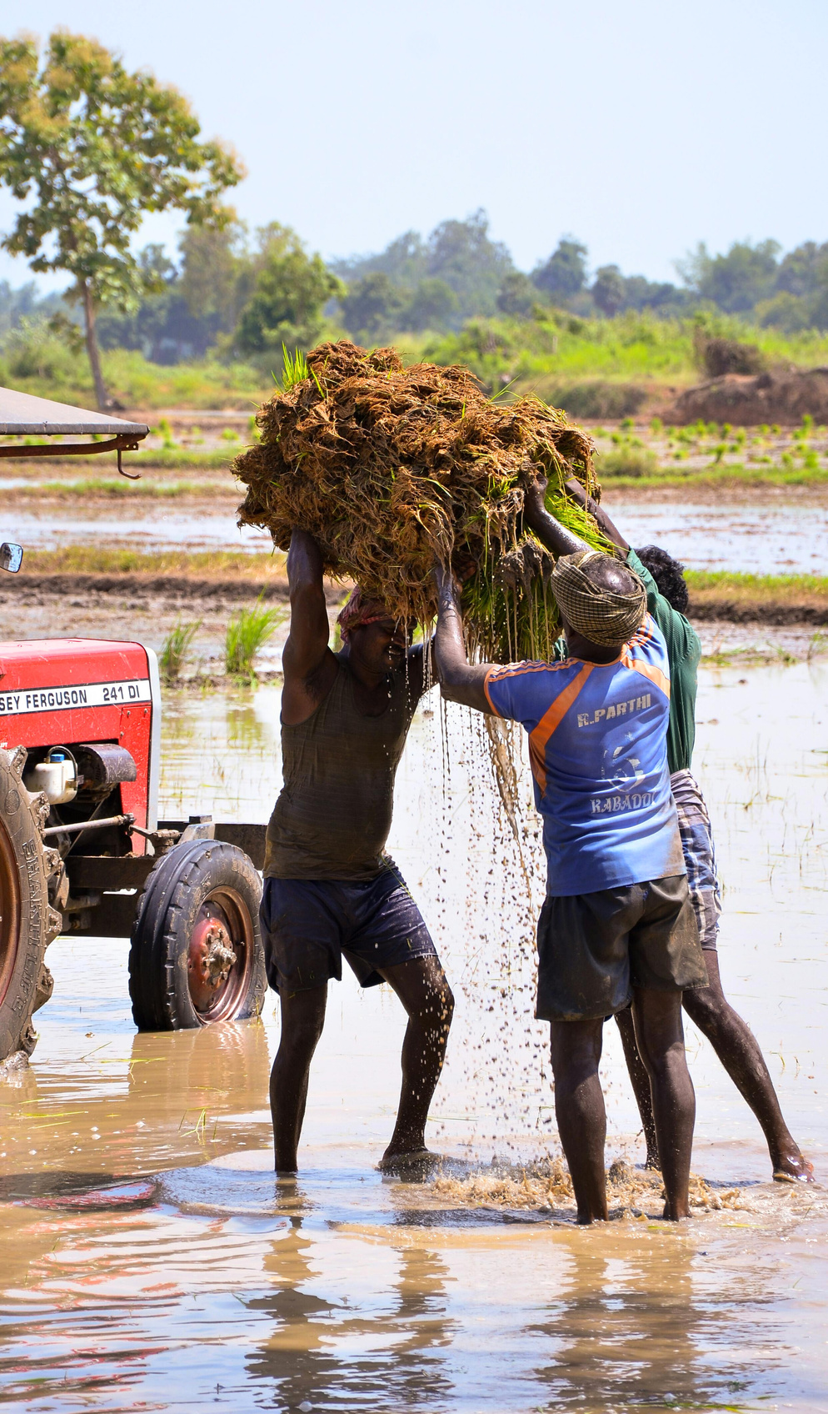
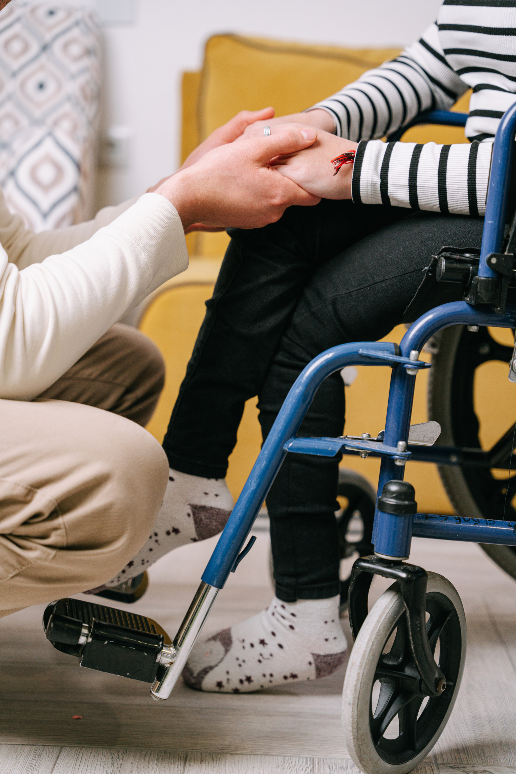
WHAT MATTERS MOST
What’s the most important factor for surviving a disaster?
Social
CONNECTION
Notes:
When we talk about disaster preparedness, most people immediately think about supplies — flashlights, batteries, water, food. And yes, those things are important. But the biggest factor in whether people make it through a disaster safely isn’t what’s in their go-bag — it’s how connected they are to the people around them.
If you know your neighbors, if you’ve talked through what to do and how to help one another, your whole street is already way ahead of the game.
We saw this in places that have been through major disasters — communities that were more connected bounced back faster and had fewer injuries and losses.
“It really comes down to this: in those first hours after an event, we are each other’s first responders. That’s what Ready Nodes are all about — creating those relationships before something happens so we’re not meeting for the first time in a crisis.
So when we say ‘neighbors helping neighbors,’ it’s not just a nice phrase — it’s the heart of resilience.”

Slide 5
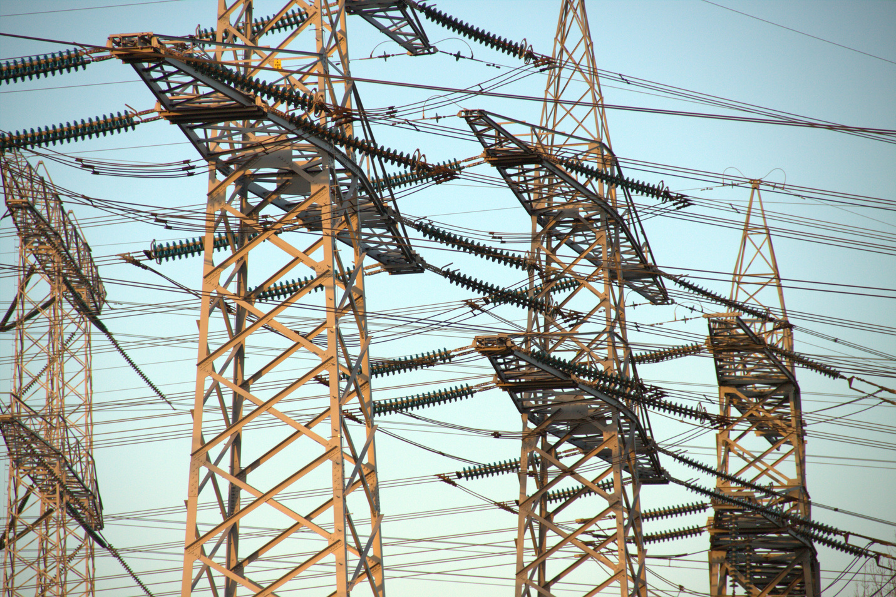
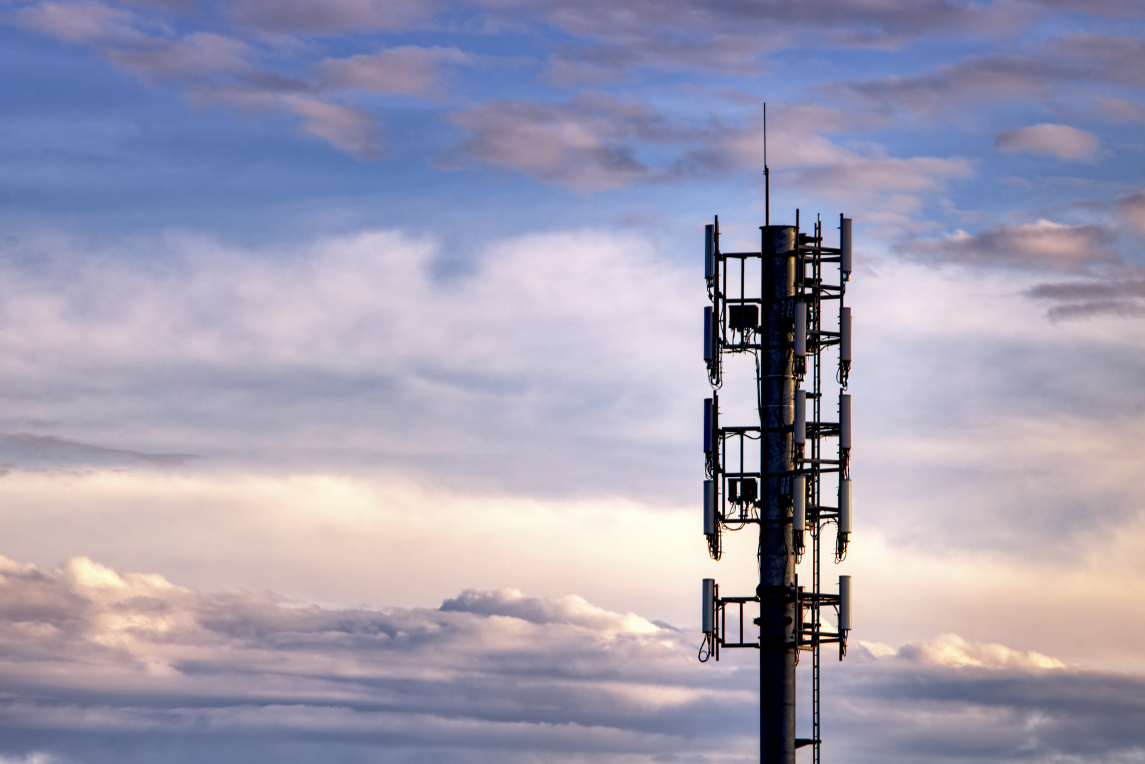
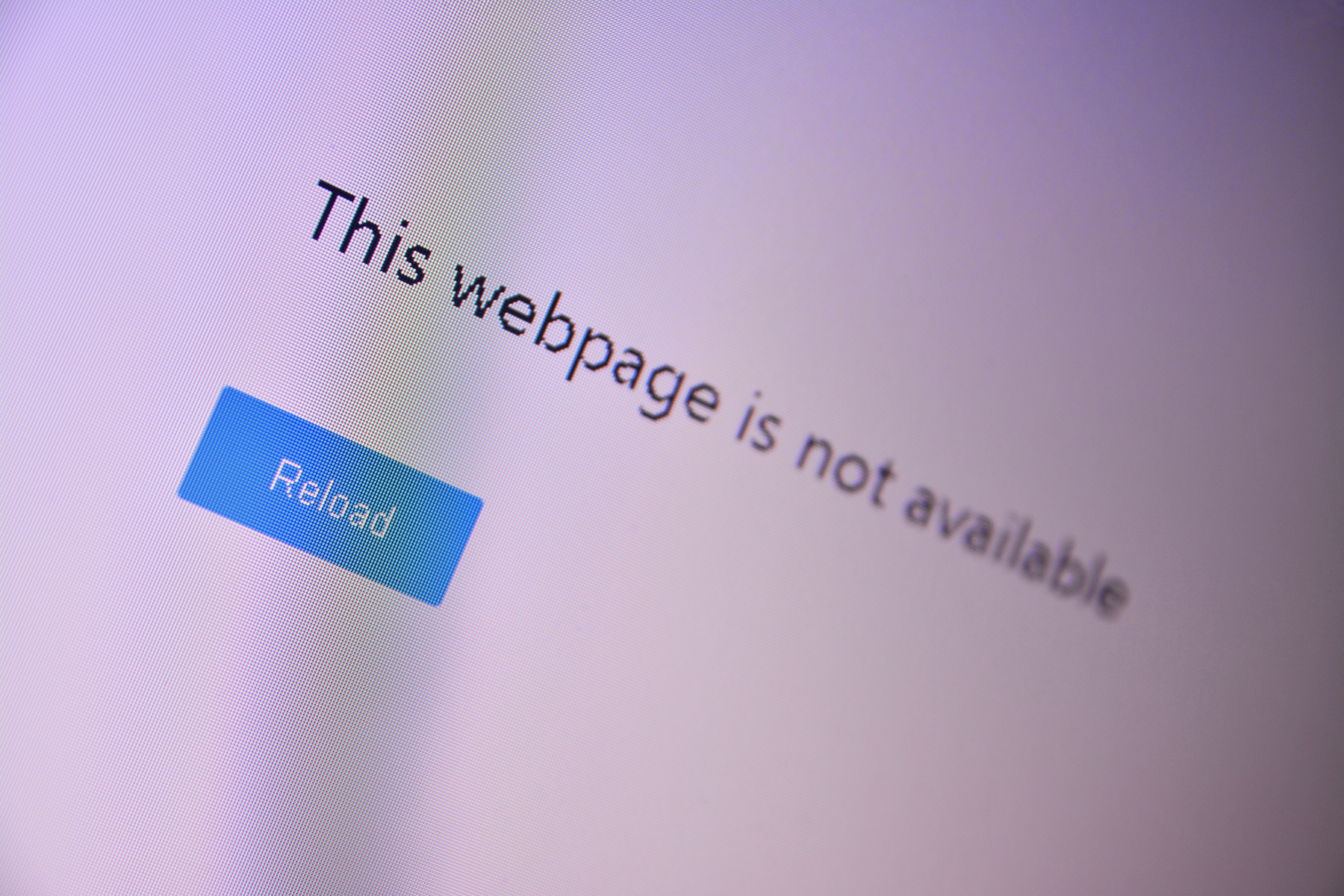
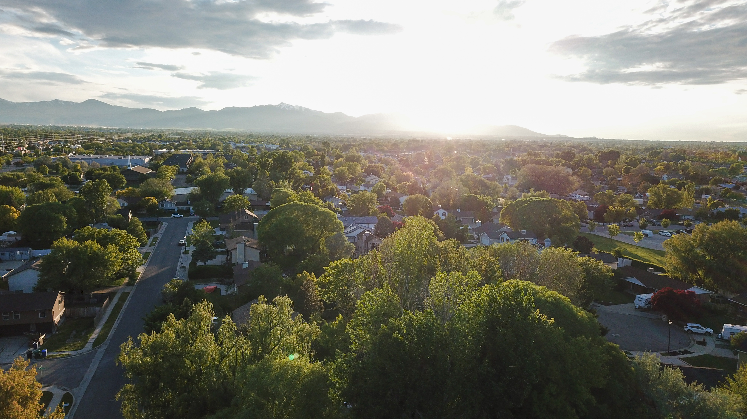
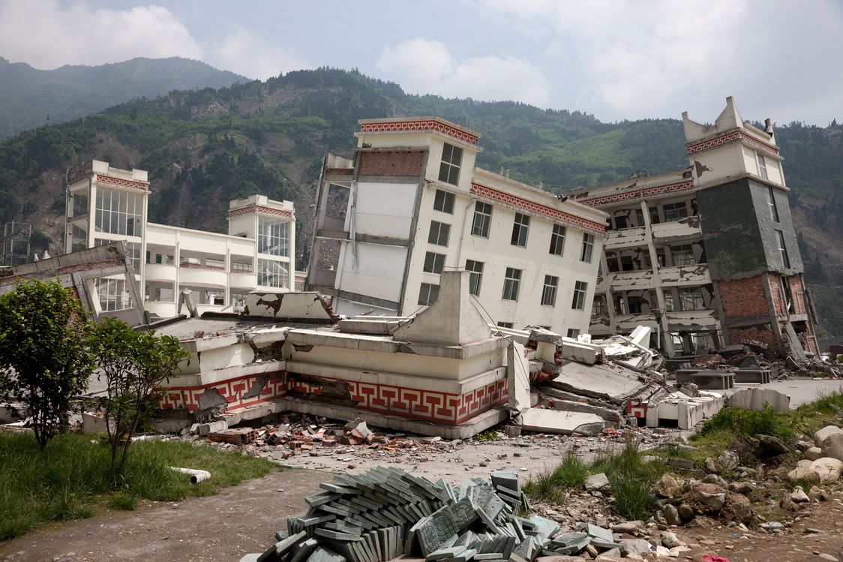
WHEN SYSTEMS GO DOWN
Tree removal raises flooding
Notes:
After a big earthquake or major disaster, a lot of the systems we rely on every single day may not work — 911, cell service, power, even water and gas. It’s not that help isn’t coming — it’s just that it may take a while.
That’s why it’s so important for us to be ready to take care of each other in those first few hours or days. When the lights are out and communication lines are down, your neighborhood becomes your safety net.
Think about it — the people on your street are the ones who will notice if a tree’s blocking your driveway, if someone’s hurt, or if a neighbor’s house is damaged.
We can’t control when the next disaster happens, but we can control how prepared we are as a community. The more we plan now — where to meet, how to share information, who has what resources — the better off we’ll all be.
Ready Nodes are built for exactly that kind of situation — simple, low-tech, and dependable when everything else is down.

Slide 6
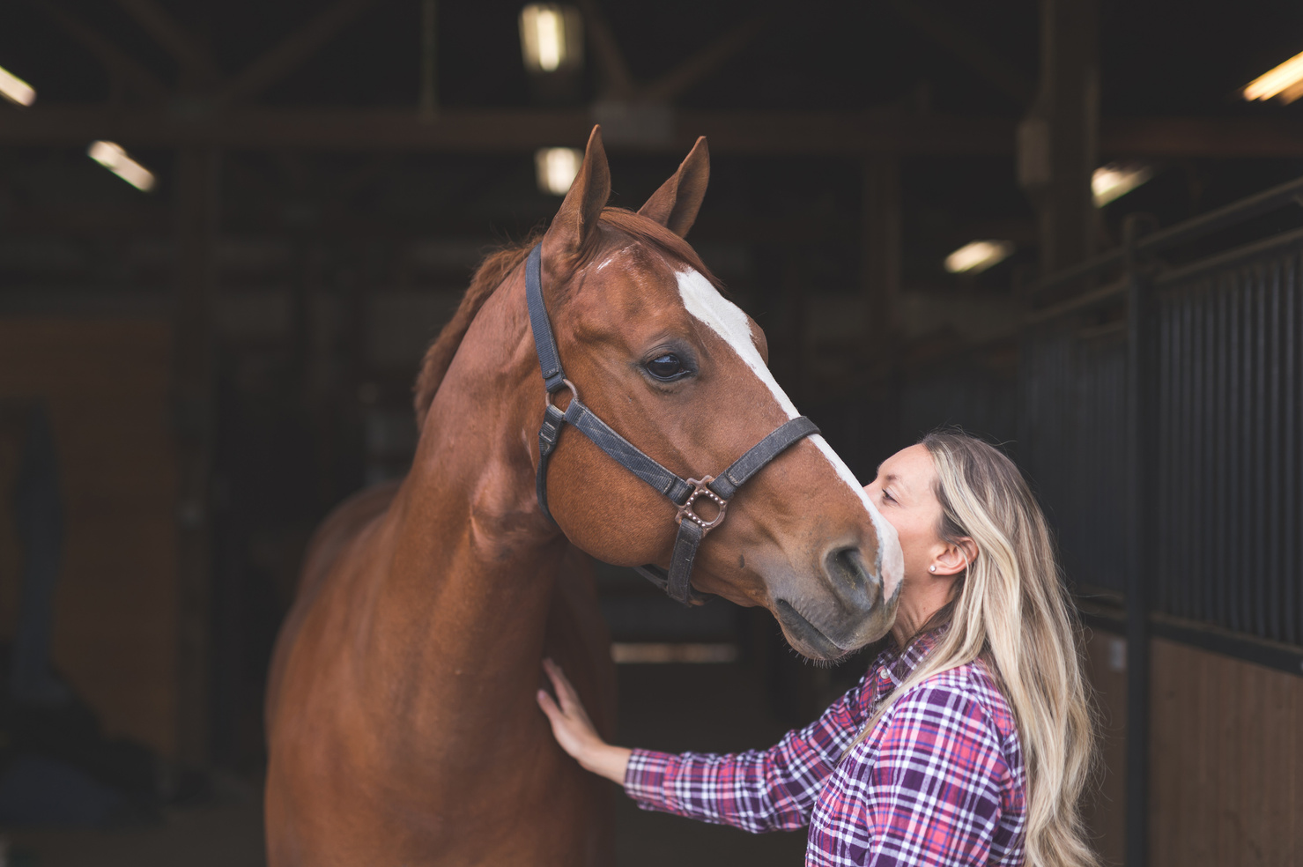
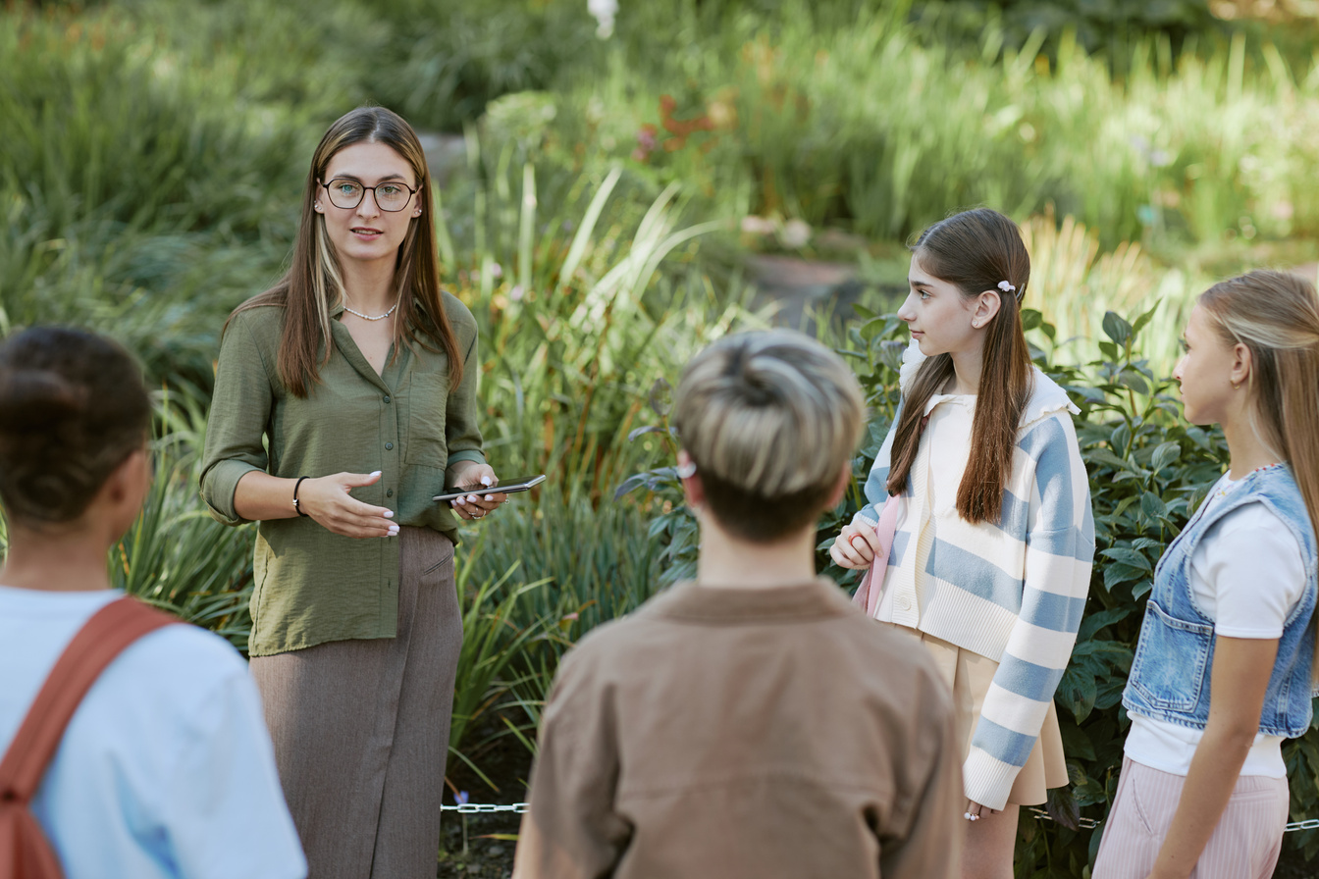
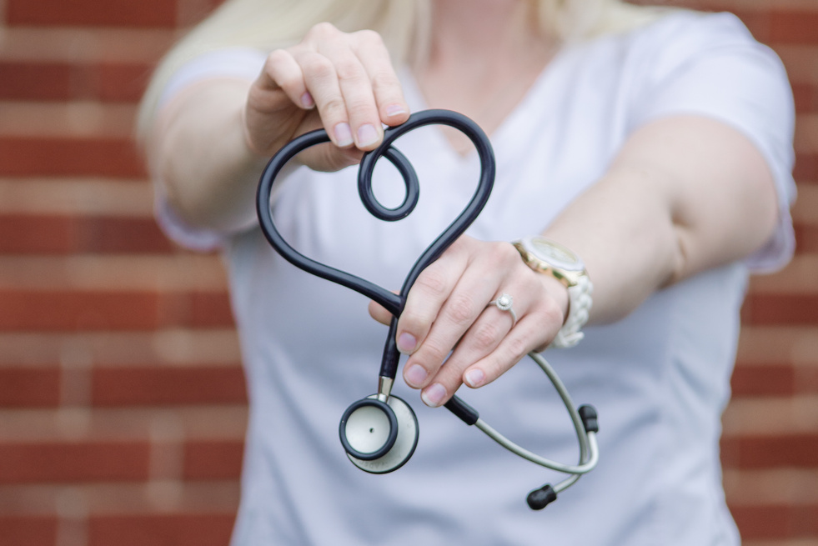
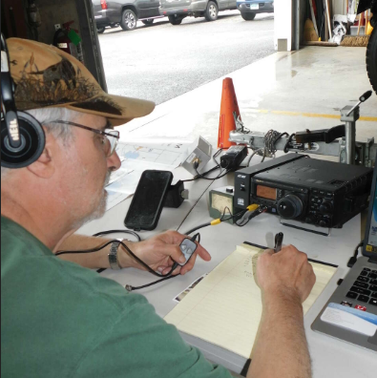
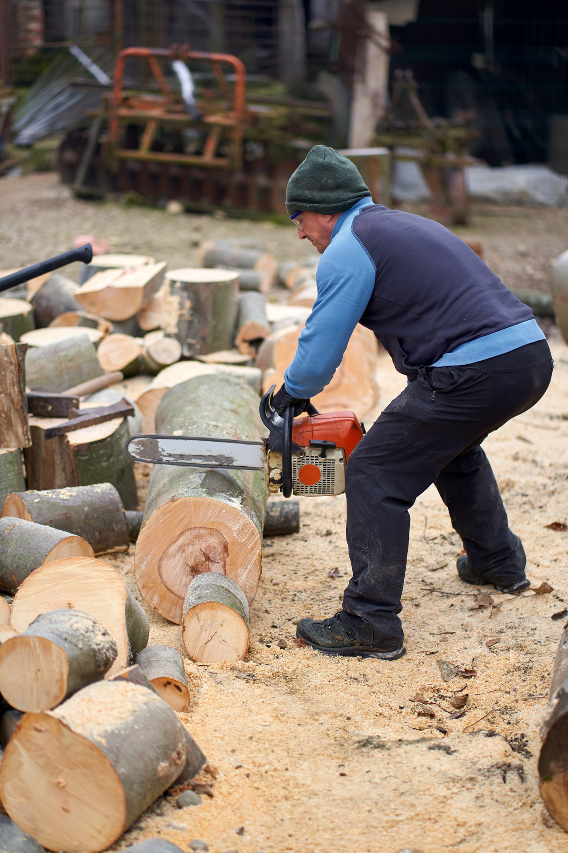
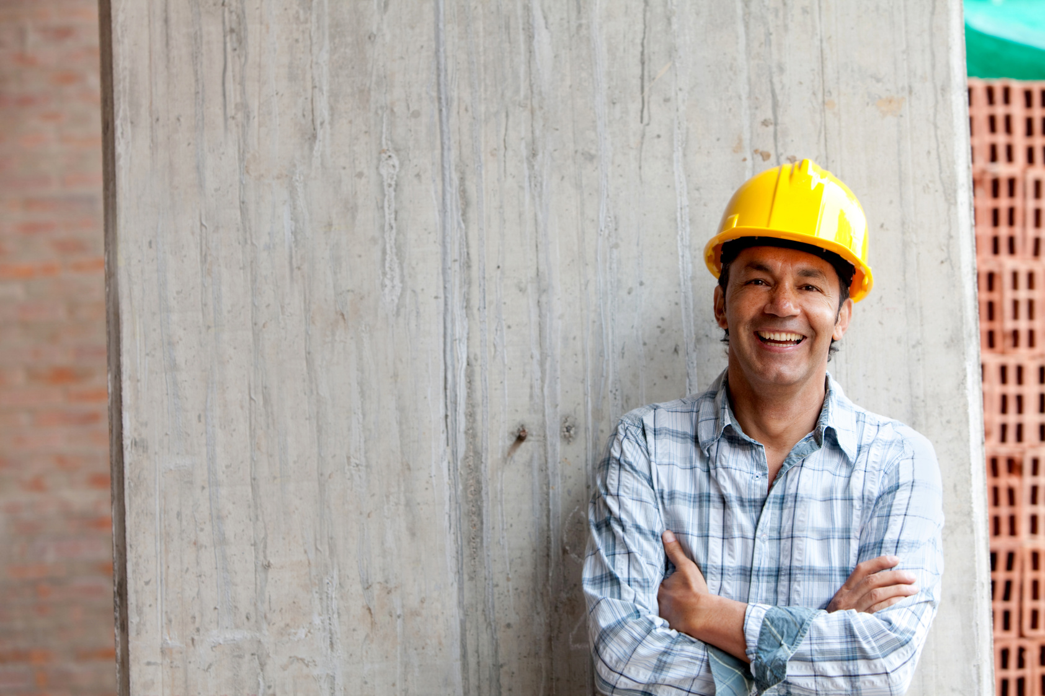
HIDDEN STRENGTHS
Our Neighborhoods Are Stronger Than We Think
Notes:
Every neighborhood already has more resources than most people realize — we just don’t always know what they are or who has them.
You might have a neighbor who’s a nurse, another who’s a contractor, someone with a generator, or someone who just happens to have extra tarps or chainsaws in their garage. Those things can make a huge difference after a disaster.
The problem is, we usually don’t find that out until after something happens — and by then, it’s too late to coordinate.
Ready Nodes change that. They help us figure out what strengths and skills already exist right here at home — before an emergency. Then, when something does happen, we can connect those resources quickly and effectively.
It’s not about building something new — it’s about connecting what we already have.

Slide 7
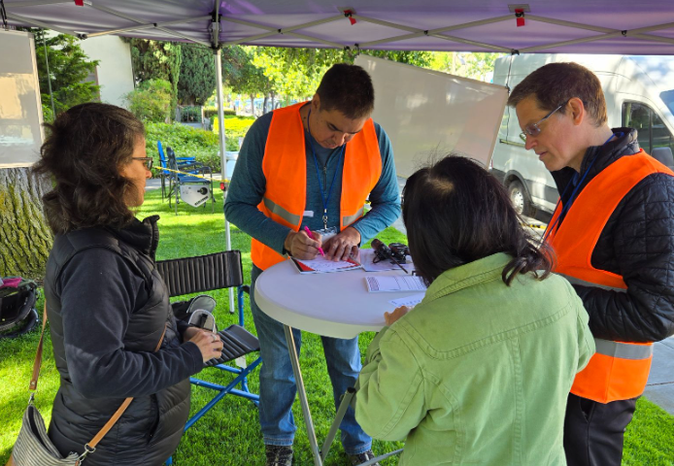
WHAT IS A READY NODE?
Local meeting spot for coordination
Uses low-tech info systems
Run by community volunteers
Complements CERT and WFPD operations
Notes:
So what exactly is a Ready Node? Think of it as a local meeting spot — a place where neighbors can come together to share information, check in, and figure out what’s needed after an emergency.
It’s intentionally low-tech. We’re not relying on cell phones or the internet. Instead, it’s things like a message board, a few radios, runners going back and forth between streets — simple, reliable ways to communicate when everything else is down.
Each Node has a few trained volunteers who help organize and keep things running smoothly, but the goal is for everyone to be involved — not just a small group.
Ready Nodes are designed to complement our CERT program — not replace it. CERT focuses on response: search and rescue, first aid, damage assessment. The Ready Node focuses on coordination: matching needs and resources in the neighborhood.
And together, they create a really strong local safety net — one that’s powered by the community itself.

Slide 8
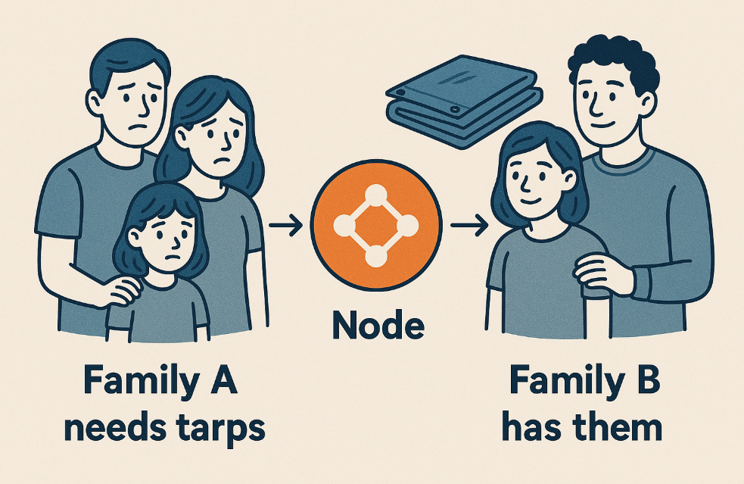
HOW IT WORKS
Neighbors helping neighbors - quickly and safely.
Notes:
Let’s walk through a quick example. Imagine it’s the day after a major earthquake. It’s pouring rain, and one family has a damaged roof. They need tarps to keep the water out — but stores are closed and phones aren’t working.
A few blocks away, another neighbor has a stack of tarps in their garage. They’d be happy to share — but they don’t know anyone needs them.
That’s where the Ready Node comes in. It acts as the neighborhood’s information hub — connecting people who need help with people who can help.
The Node is also where people can post updates — who’s okay, where there’s damage, where first aid is being offered, or if anyone needs special assistance.
It’s simple, low-tech coordination — but it makes a huge difference. It turns confusion into communication.
And when you add radios and Ready Communicators into the mix, those Nodes can share updates between neighborhoods and even up to the Fire District or CERT Command.

Slide 9
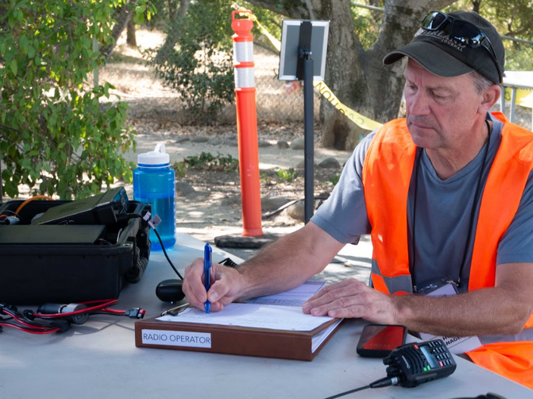
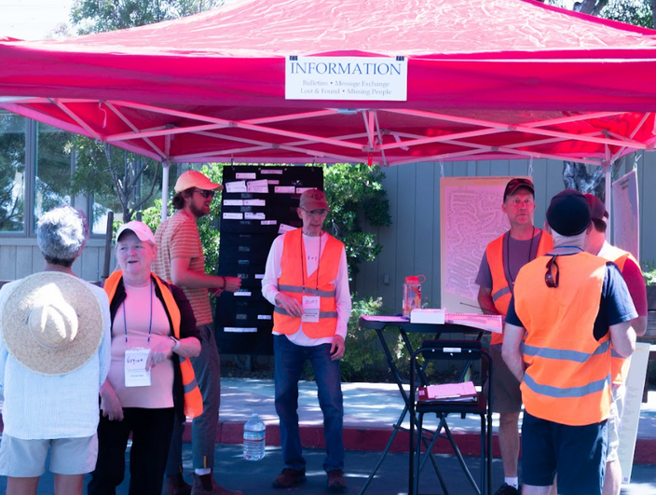
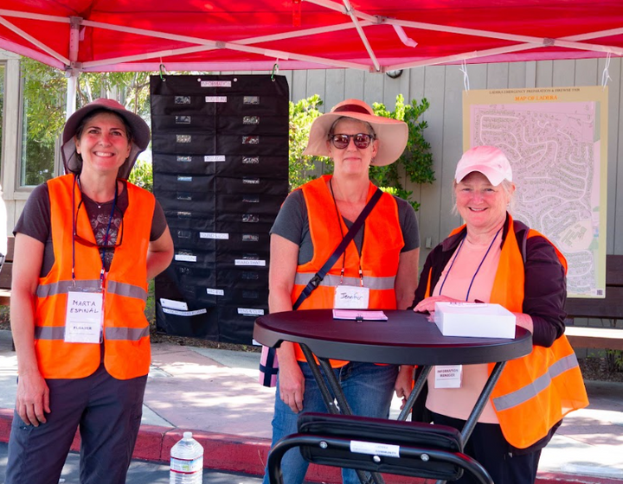
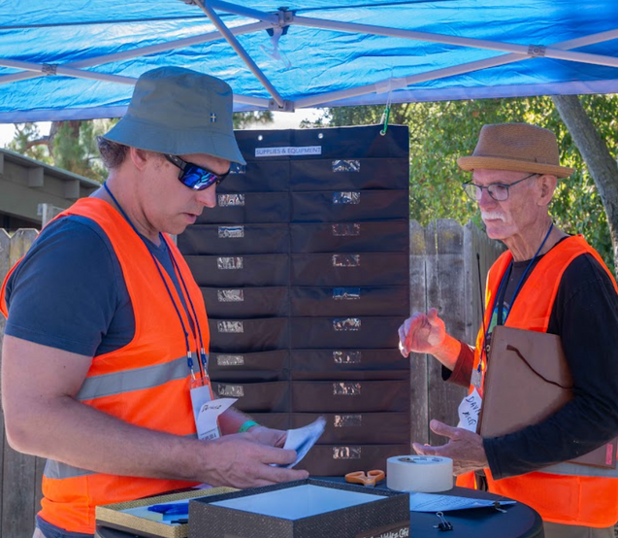
NODES SHARE WHAT MATTERS
Notes:
One of the most important things during any emergency is communication — accurate information, shared quickly.
Each Ready Node becomes the go-to spot for updates in the neighborhood. It’s where you can find out what’s going on, what resources are available, or where help is needed.
Think of it like the community bulletin board — but with a purpose. Messages can be posted by hand, passed through runners, or relayed over our radios.
This is also where our Ready Communicators come in. They’re trained volunteers who use radios to connect each Node with our CERT and Fire District command.
So even if phone lines and power are out, information can still move — street to street, Node to Node — keeping everyone in the loop.
When people know what’s happening, panic goes down and coordination goes up. It’s how we keep calm and stay connected.

Slide 10
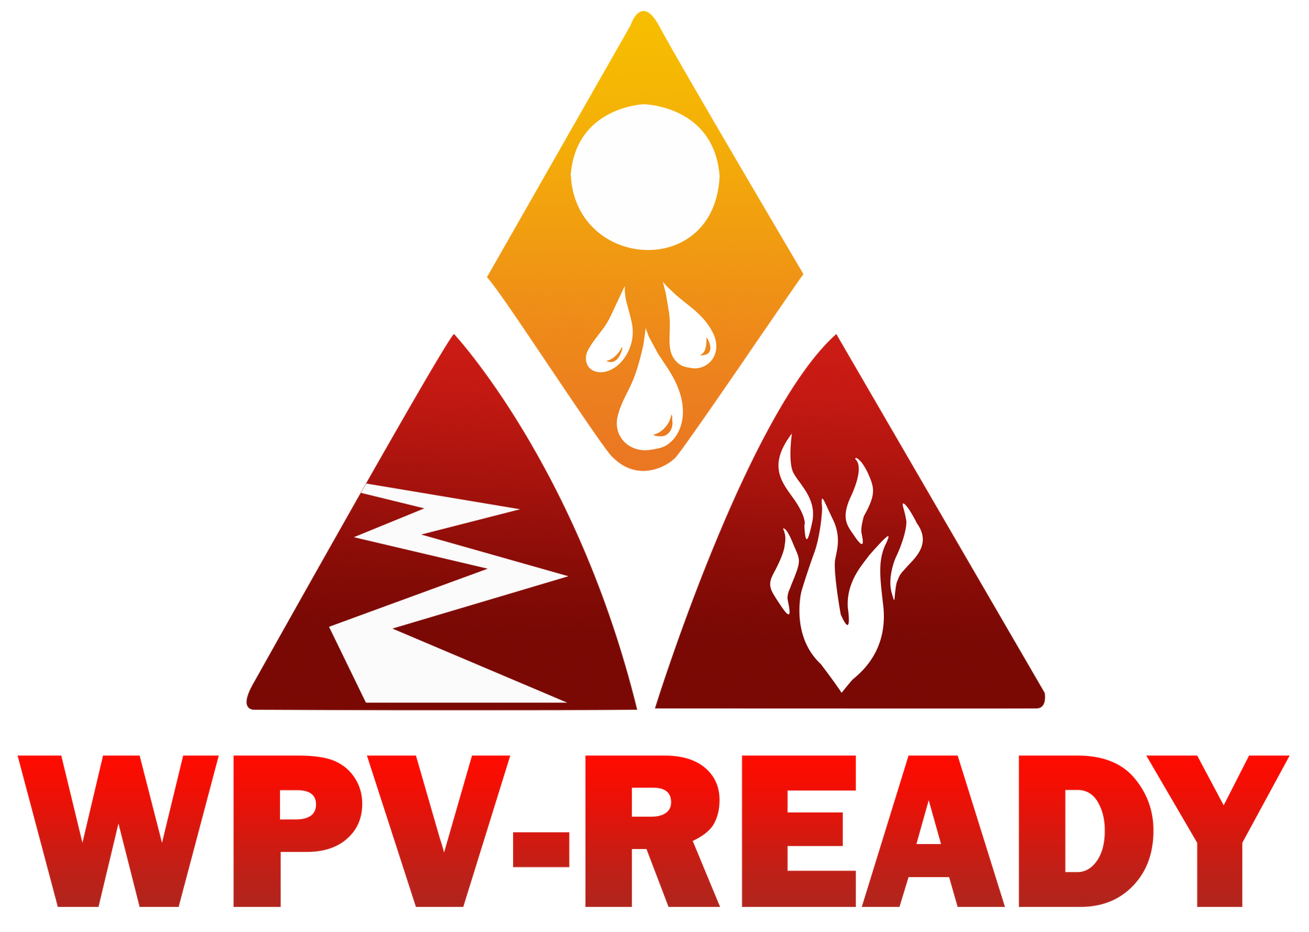
WPV-CERT
READY NODES
Together they build community resilience
Notes:
Our CERT program and the Ready Node concept go hand-in-hand — they’re two parts of the same neighborhood preparedness system.
CERT volunteers are trained for emergency response: things like light search and rescue, first aid, and damage assessment.
Ready Nodes focus on coordination — they gather information, match up resources, and share updates with CERT command.
So while CERT might be out in the field helping people who are injured or assessing damage, the Node team is keeping track of who needs what and who’s available to help.
The two groups work side-by-side, and together they create a full circle of preparedness — communication, coordination, and response.
Ideally, every neighborhood has both: a Ready Node that keeps information flowing and CERT-trained neighbors who can respond safely and effectively.
That combination is what makes our WPV communities strong, self-sufficient, and ready for whatever comes our way.

Slide 11
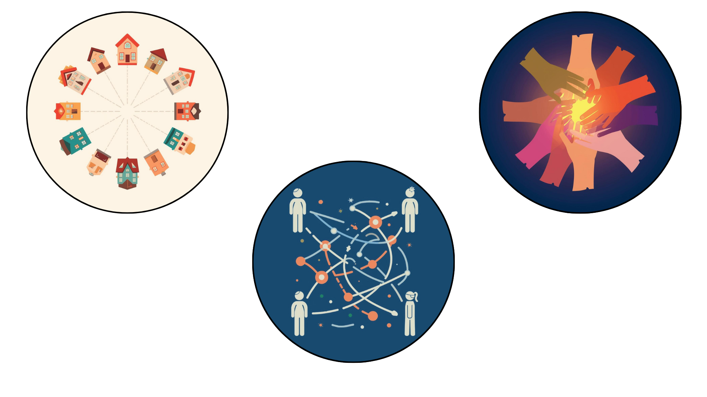
Preparedness Starts with Neighbors
Share Information
Stay Connected
Be Resilient
Notes:
In the first hours of any disruption,
neighbors are often the first source of information and support.
WPV-Ready Nodes help neighborhoods stay connected, share information, and look out for one another when normal systems may not be working.
Preparedness doesn’t start with equipment — it starts with relationships. Ready Nodes simply give neighbors an easy way to stay connected when it matters most.

Slide 12
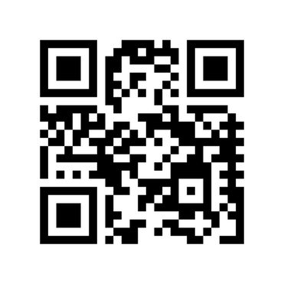
BE PART OF THE NETWORK
  Join or form a Ready Node in your area
  Attend WPV-Ready practice events
  Become a Ready Communicator
Next Communicator Training
April 21st
6:30-9:30pm
Notes:
The best part about this program is how easy it is to get involved — you don’t need special training or a background in emergency response.”
If you’re the kind of person who knows your neighbors, or you’re willing to lend a hand when things go sideways — you’re exactly who we need.
You can start by joining a Ready Node that’s already active in your area, or help form one if your neighborhood doesn’t have one yet.
We offer short trainings, practice events, and our Ready Communicator program, which teaches you how to use radios to link neighborhoods together. It’s fun, it’s useful, and it’s one of the most practical ways you can help.
We do regular radio check-ins every week and practice drills so you can stay sharp — and you’ll meet great people in the process.
Everything you need — schedules, sign-ups, and info — is on WPV-Ready.org. You can also reach out directly to me at Woodside Fire if you’d like help getting started in your neighborhood.
The more of us who are trained and connected, the faster we’ll recover when disaster strikes. It’s really about building a culture of readiness — one neighborhood at a time.

Slide 13
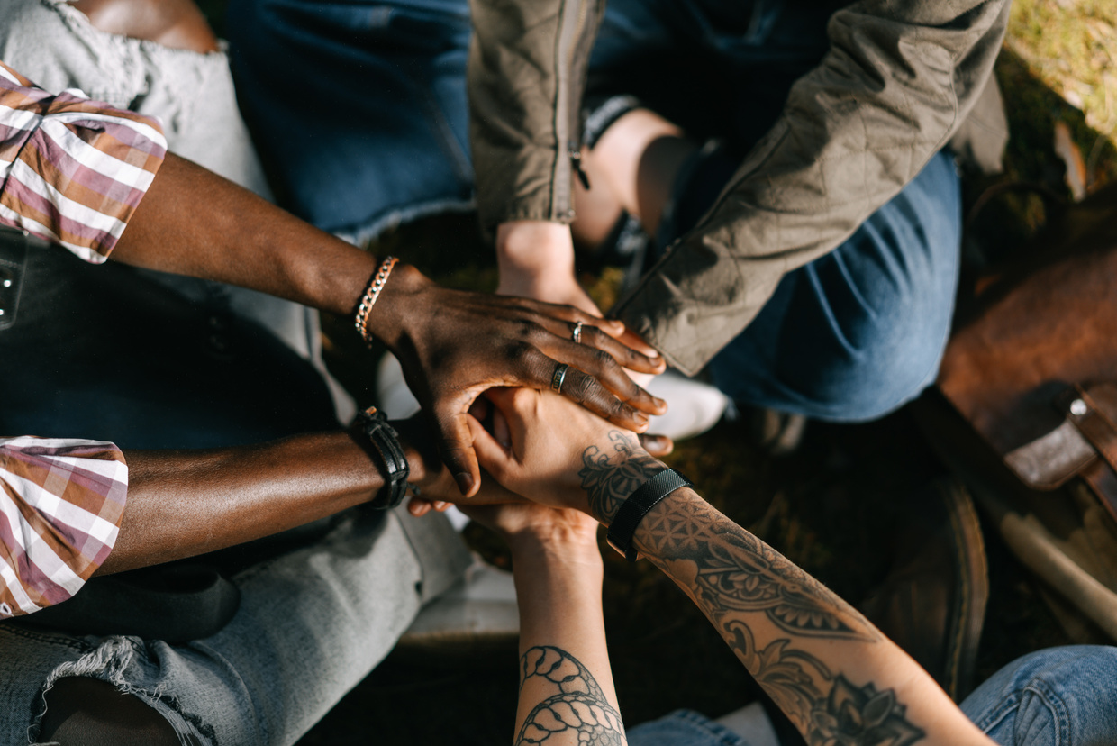
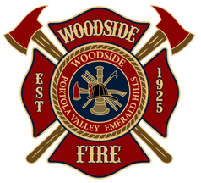
THANK YOU!
Selena Brown
Public Education Officer/Emergency Preparedness Coordinator
sbrown@woodsidefire.gov
www.WPV-Ready.org
www.Woodsidefire.org
(650) 547-9874
Notes:
I just want to take a moment to thank all of you for being here today — for showing up, asking questions, and caring about your community.”
Preparedness isn’t about fear — it’s about confidence. It’s about knowing that when something happens, we already have a plan and a network of people ready to act.
When we build connections before a disaster, we’re not just preparing for the worst — we’re strengthening our neighborhoods every single day.
That’s what Ready Nodes are really about — turning neighbors into a team.
If you’d like to learn more, visit WPV-Ready.org or connect with me after the presentation. We’ll help you link up with your local Node or start one if your area doesn’t have one yet.
Together with WPV-CERT and Woodside Fire, we’re building something powerful — a community that’s truly ready for anything.
Thank you for helping make that possible.

